Slide 1


Customer Shopping Behavior Analysis
Uncovering insights from transactional data to guide strategic business decisions.

Slide 2

Project Overview & Dataset
1
2
Project Goal
Dataset Size
Analyze 3,900 purchases to understand spending, segments, preferences, and subscriptions.
3,900 rows, 18 columns. Key features: demographics, purchase details, shopping behavior.
3
Missing Data
37 values in Review Rating column.

Slide 3
Exploratory Data Analysis (Python)
01
02
03
Data Loading & Exploration
Missing Data Handling
Column Standardization
Imported with pandas, checked structure and summary statistics.
Imputed Review Rating using median per category.
Renamed columns to snake_case for readability.
04
05
Feature Engineering
Database Integration
Created age_group and purchase_frequency_days.
Loaded cleaned data into PostgreSQL for SQL analysis.

Slide 4
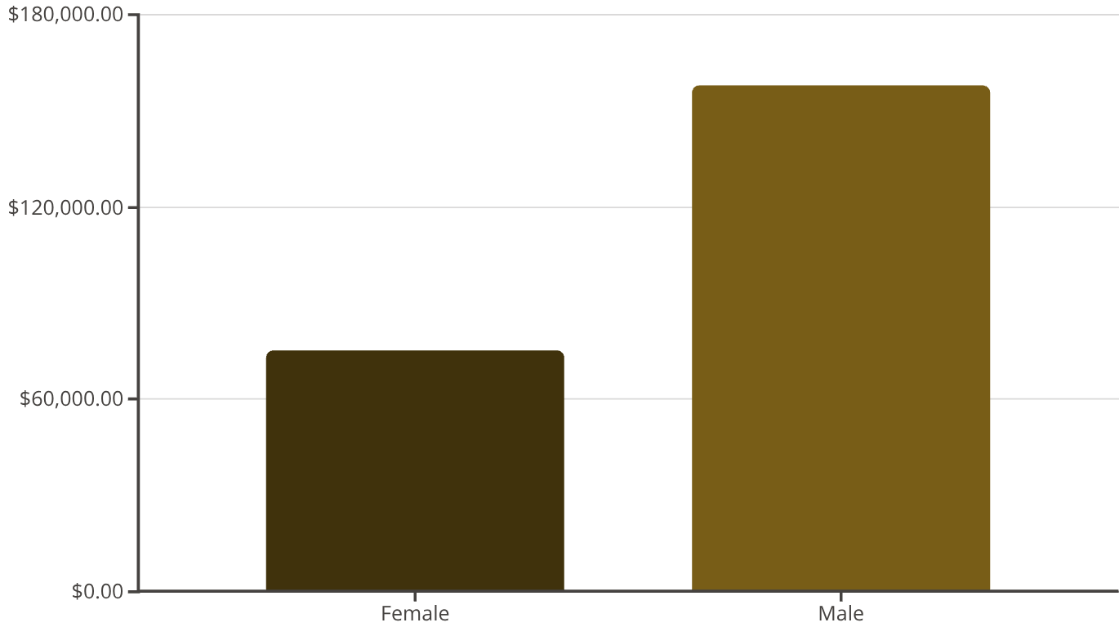

Key Insights: Revenue & Discounts
Revenue by Gender
High-Spending Discount Users
839 customers used discounts but spent above average.

Slide 5
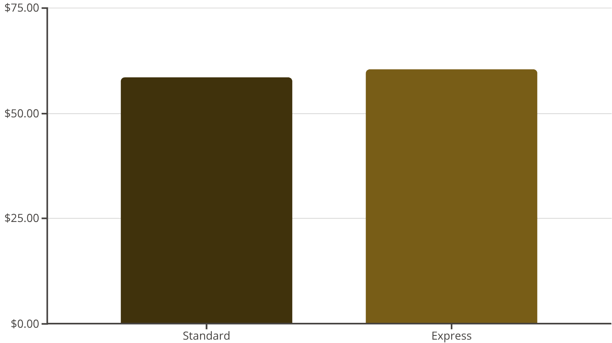
Product Performance & Shipping
Top 5 Products by Rating
Shipping Type Comparison
Gloves: 3.86
Sandals: 3.84
Boots: 3.82
Hat: 3.80
Skirt: 3.78

Slide 6

Subscription & Discount Dependency
Subscribers vs. Non-Subscribers
Discount-Dependent Products
Subscribers: 1053 customers, avg spend $59.49, total revenue $62,645.
Hat: 50.00% discounted
Sneakers: 49.66% discounted
Coat: 49.07% discounted
Non-Subscribers: 2847 customers, avg spend $59.87, total revenue $170,436.
Sweater: 48.17% discounted
Pants: 47.37% discounted

Slide 7


Customer Segmentation
Loyal
Returning
3116 Customers
701 Customers
New
83 Customers

Slide 8
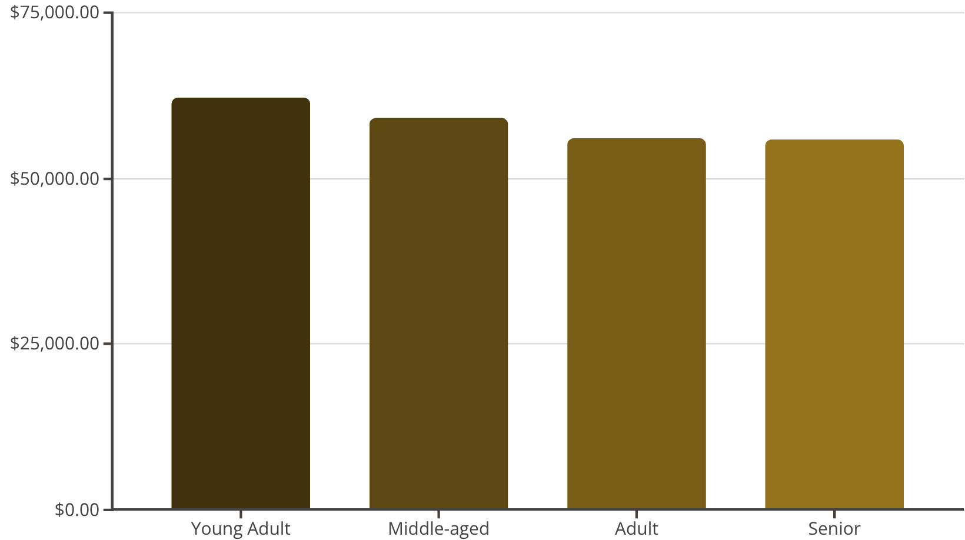
Top Products by Category & Age
Top 3 Products per Category
Revenue by Age Group
Accessories: Jewelry, Sunglasses, Belt
Clothing: Blouse, Pants, Shirt
Footwear: Sandals, Shoes, Sneakers
Outerwear: Jacket, Coat

Slide 9
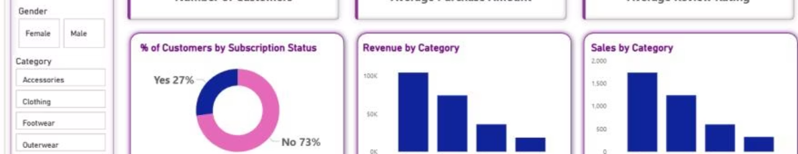
Repeat Buyers & Subscriptions
Repeat Buyers & Subscriptions
Dashboard Overview
Customers with >5 purchases:
Interactive Power BI dashboard for visual insights.
No Subscription: 2518
3.9K Customers, $59.76 Avg Purchase, 3.75 Avg Review Rating.
Yes Subscription: 958
27% Subscribers, 73% Non-Subscribers.

Slide 10
Business Recommendations
Boost Subscriptions
Promote exclusive benefits for subscribers.
Customer Loyalty Programs
Reward repeat buyers to foster loyalty.
Review Discount Policy
Balance sales boosts with margin control.
Product Positioning
Highlight top-rated and best-selling products.
Targeted Marketing
Focus on high-revenue age groups and express-shipping users.

